Slide 1

Digital Board Marker
Final Year Project
Advisor:
Mr. Samyan Qayyum Wahla
Group Members:
Muhammad Haris Khan [2016-CS-105]
Hamza Farooq [2016-CS-122]
Ayesha Atif [2016-CS-152]
Komal Shehzadi [2016-CS-178]

Slide 2
OUR AGENDA
Introduction
Objectives
Scope
1
2
3
Target Audience
Applications
Existing Systems
4
5
6
Problem Statement
Proposed System
Feasibility
7
8
9
Requirements
10

Slide 3
Overview
Bandwidth Efficient System
Storage Efficient System
Offline Lecture Player
Complete LMS

Slide 4
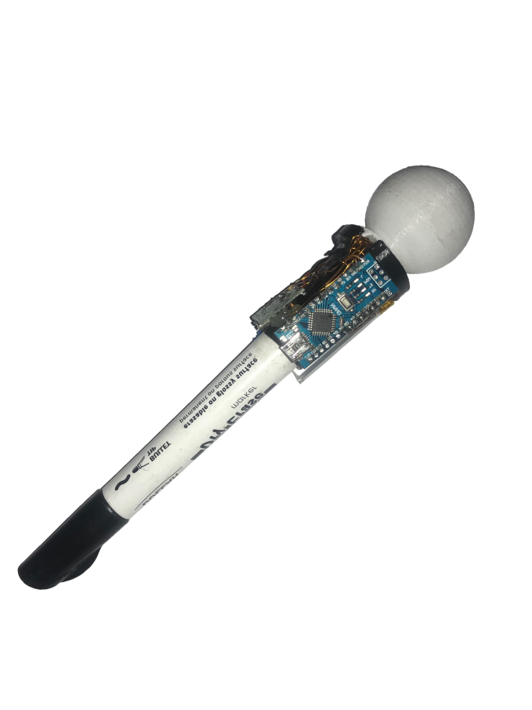
Motivation
Minimizing Resources
Difficulty in writing ✕tes as well as listening and understanding
Less bandwidth usage
Less storage
Play without internet

Slide 5
Objectives
Industrial Objectives
Research Objectives
Academic Objectives

Slide 6
Industry Objectives
Industrial Presentations
Fast Streaming
Minimize Resources
Bandwidth
Storage

Slide 7
Research Objectives
Machine Learning in computer vision to detect position accurately.
Psmove and PS eye to combine computer vision and orientation data for determining marker tip position.
.Net core for cross platform

Slide 8
Academic Objectives
Less internet usage
Less storage requirement
To make LMS for management of learning process.

Slide 9
Scope of Project
The proposed system will record lecture as 100 times size efficient animation as compared to regular high definition video. Lecture animation can be viewed on web application and also offline on desktop lecture player application. DBM will serve as an extended LMS. Lecture recording hardware is suitable for 16:9 aspect ratio rectangular whiteboard. Typically lecture recording will be performed using two camera stereo vision. Voice and marker position is recorded using custom developed wireless modules.

Slide 10
Target audience
Educational Institutes
Admin
Teacher
Students
Online Tutors
Tutor
Users

Slide 11

Applications Of Proposed System
Educational Institutes
Online Tutors
Sketch Artists
Industrial Presentations

Slide 12
Comparison with Existing System
Initiative | Storage Efficiency | Encrypted format | Dedicated Player | Custom Content | Brandable | Free to Access | For Profit | Class Strength
Edx | ✕ | ✕ | ✕ | ✓ | ✓ | ✓ | ✕ | 300,000
Moodle | ✕ | ✕ | ✕ | ✕ | ✓ | ✓ | ✓ | 10,000
Coursera | ✕ | ✕ | ✕ | ✓ | ✕ | ✓ | ✓ | Unlimited
Udemy | ✕ | ✕ | ✕ | ✓ | ✕ | ✕ | ✓ | Unlimited
Udacity | ✕ | ✕ | ✕ | ✓ | ✓ | ✓ | ✓ | Unlimited
DBM | ✓ | ✓ | ✓ | ✓ | ✓ | ✓ | ✕ | Unlimited

Slide 13
Problem Statement
“To make a storage and bandwidth efficient system wit h a lecture player and learning management system for the students and the educational institutes.”

Slide 14
Proposed system
Customized Player
Notes Management
DBM
Course Management
Assignment management
Announcement Management
Lecture Recoding

Slide 15
Hardware Requirements
Determine orientation of board marker and calculate respective Euler angles
Transmit the calculated Euler angles to desktop app via nrf24l01 module
1
2
Transmit the calculated Euler angles to desktop app via RS232 serial connection
Turn on using 3.6 volts Lipo battery with Boost converter circuit
3
4
Build battery charging circuit within board marker
Implement RGB Led for positioning purpose (Input for camera module)
5
6

Slide 16
Software Requirements
1
Class room Interface
2
DBM Website
SQL Server to deploy database.
Central server where all the data and files will be stored.
Arduino 1.8.9
Processing 3.5.3
Visual studio 15
Cl-eye driver
Emgu 4.1
Colormine NuGet package
3
Offline Player
Offline player needs to be installed on stable version of windows. If .net framework with suit able version is available in the pc then it can be installed without manifest files other wise we have to inst all it with them.

Slide 17
Modules of Proposed System
Board Marker
LMS
Offline Player

Slide 18
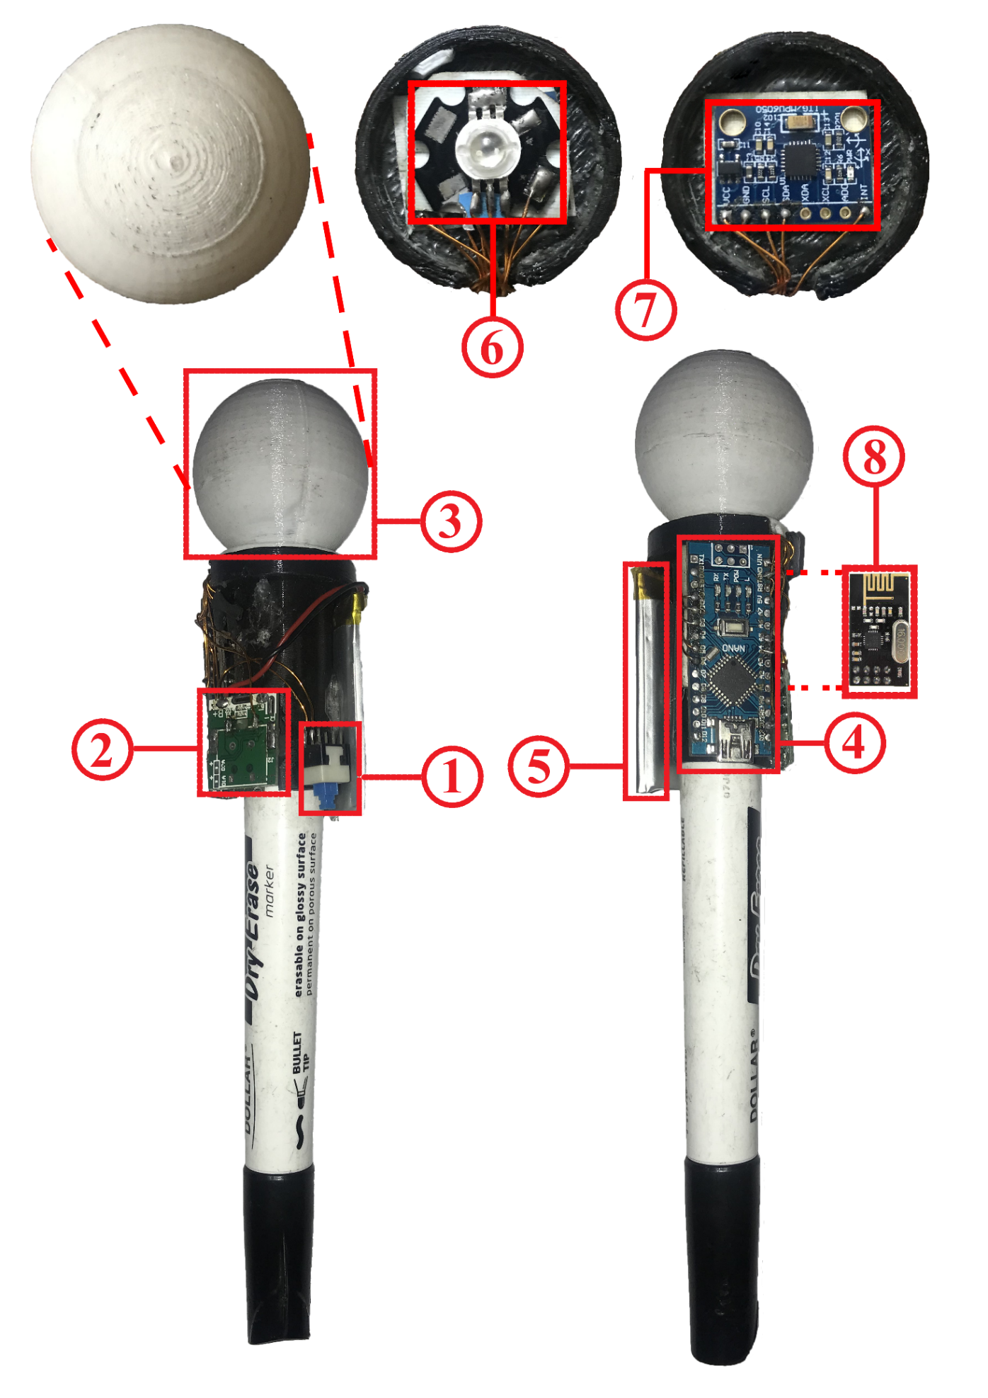
Board Marker
Tact Tactile Switch:
Toggle switch that turns on/off the system when runs on Battery. It does not have any effect when system is running via USB cable.
USB DC-DC Boost Converter:
Converts the 3.7V to 5V to turn on and constantly run the Arduino nano prototype board.
Glowing ball:
Round shaped glowing ball can glow in any combination of RGB colors.
Arduino nano:
Arduino nano acts as main processing board. It acts just like a motherboard

Slide 19
Board Marker(Contd.)
8. Lipo battery:
600mAh 3.7V Lipo battery used to run system while there is no USB connection. Voltage may be up to 4.2 volts when fully charged.
9. dc-le14112 RGB Led:
3W RGB Led used to create custom color of choice, the corresponding color that is required for position sensing can glow in Glowing ball.
10. MPU-6050:
MPU-6050 or GY-521 board contains accelerometer and gyroscope packed in a single chip.
11. nRF24L01:
nRF24L01 is a single chip radio transceiver. It is responsible for transmitting orientation data from transmitter module to receiver.

Slide 20
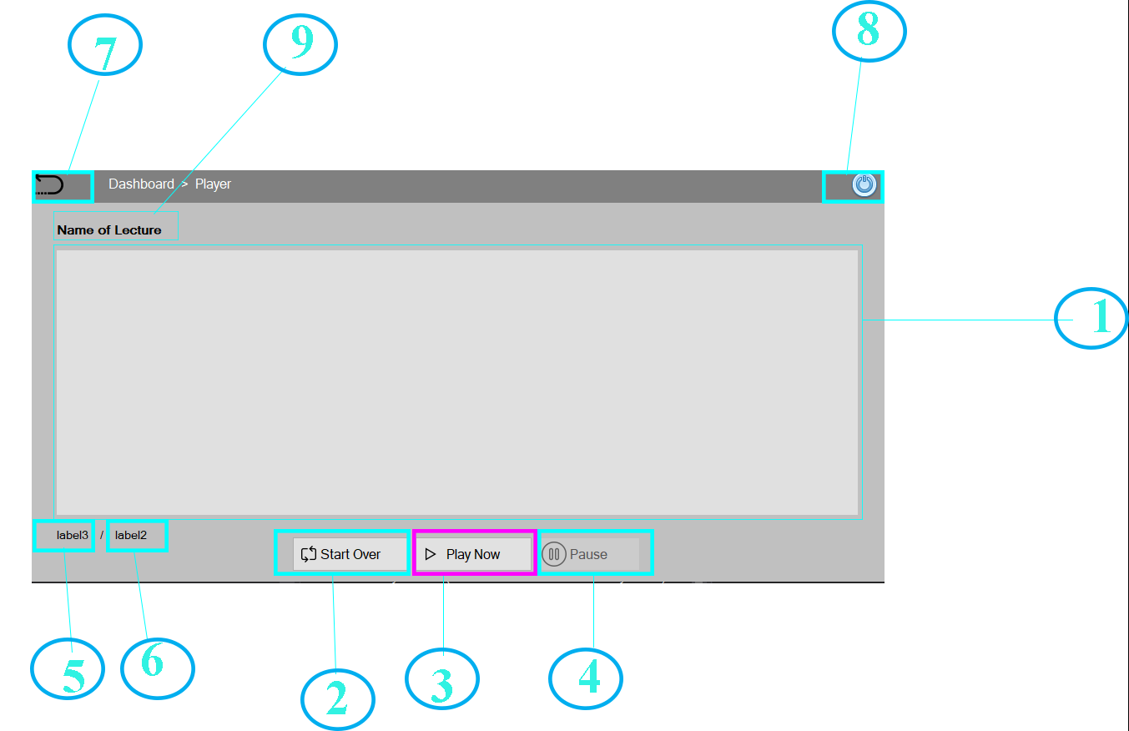
Offline Player

Slide 21
Offline Player
1. Player Screen:
Player screen is a place where animated video drawn by data in json file will be played.
2. Start Over Button :
This button is responsible for suspending all the threads except main thread and play the video, audio and timer from the start.
3. Play Now Button :
This play now button starts three new threads of audio, video and timer start it is responsible to play video at start.
4. Pause Button:
It pauses the audio, video and timer at a specific time when they have been played. It suspends all threads which are responsible to play video for a time being.
5. Elapsed Time Label:
This label is responsible to show the elapsed time to the user so that he can keep track of video.

Slide 22
Offline Player(Contd)
6. Total Time Label:
This label shows total time of video at which it will be finished.
7. Go-Back Button:
This button takes the user to the previous screen of lecture playlist where he or she can select any other lecture to download and play.
8. Exit Button:
As it is quite obvious by the name it exits the application.
9. Name of Lecture Label :
This label shows the name of lecture currently playing on the player selected by the user on previous screen.

Slide 23
Web Application
Admin:
Admin can approve teachers and student registration requests.
Admin can add new courses.
Admin can assign courses to teacher.
Teacher:
Teacher can register and then login to his/her account.
Teacher can approve enrolment request of students.
Teacher can upload course notes.
Teacher can upload assignments.
Teacher can download all students submitted assignments.

Slide 24
Web Application(Contd.)
Student:
Student can register and then login to his/her account.
Student can see lectures.
Student can see and download notes.
Student can see and download assignments.
Student can submit assignments.
Student can enroll in course.

Slide 25
Thank You!

